Slide 1
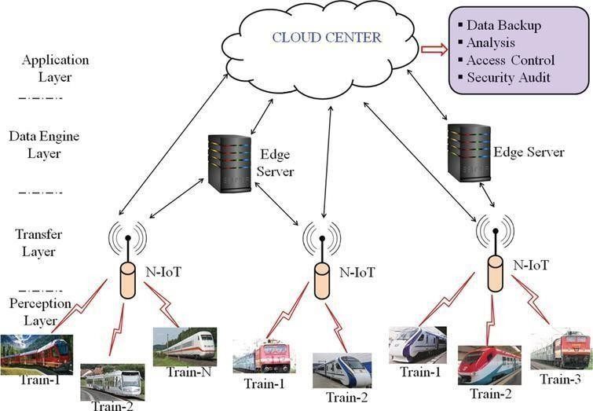
TEAM ID | PNT2022TMID25992
PROJECT NAME | SMART SOLUTIONS FOR RAILWAYS
PROJECT DEVELOPMENT DELIVERY OF SPRINT-2
Proposed architecture for smart track monitoring system:

Slide 2
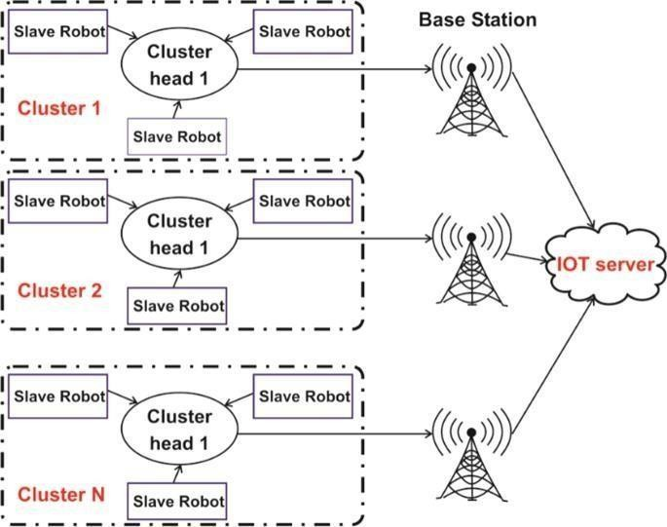
Structural health monitoring of railway tracks usingIOT- based multi robot system:

